Slide 1
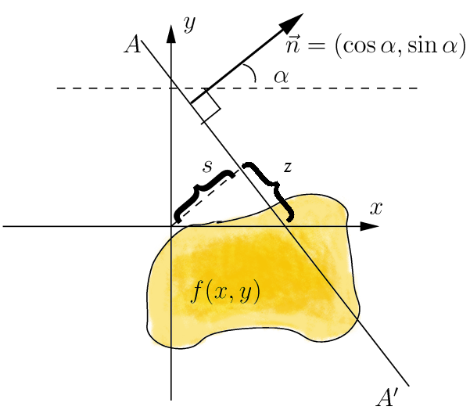
Computerized Tomography
Demonstrating Non-Locality in Even Dimensions (2D)
Ariel Fuxman, Gilad Zusman & Tamar Entin

Slide 2


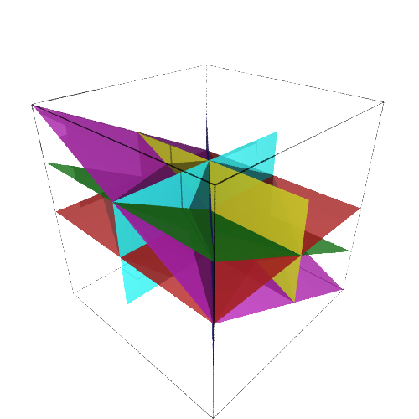
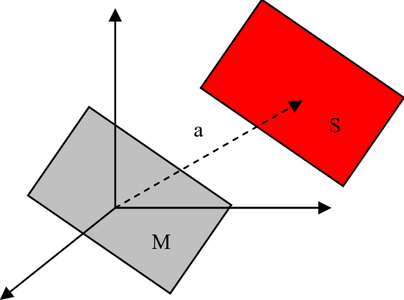
The Definition of the Radon Transform

Slide 3

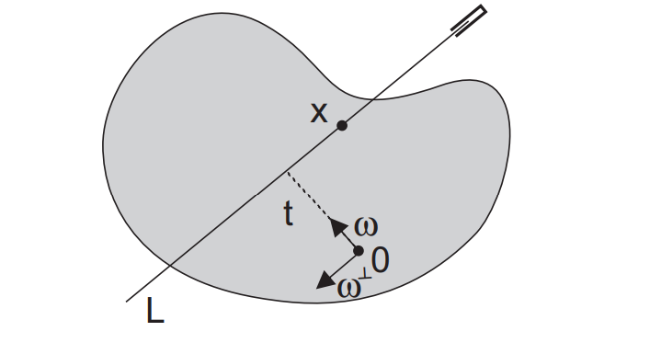
Parameterization

Slide 4
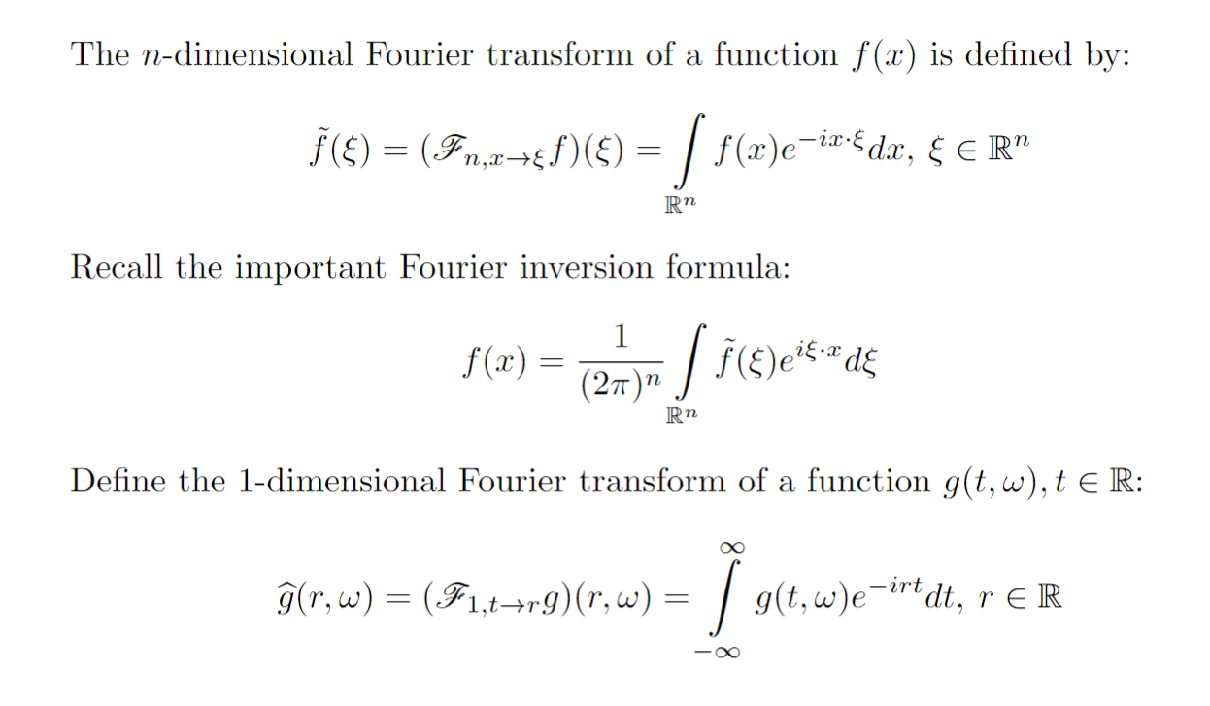
The Fourier Transform

Slide 5
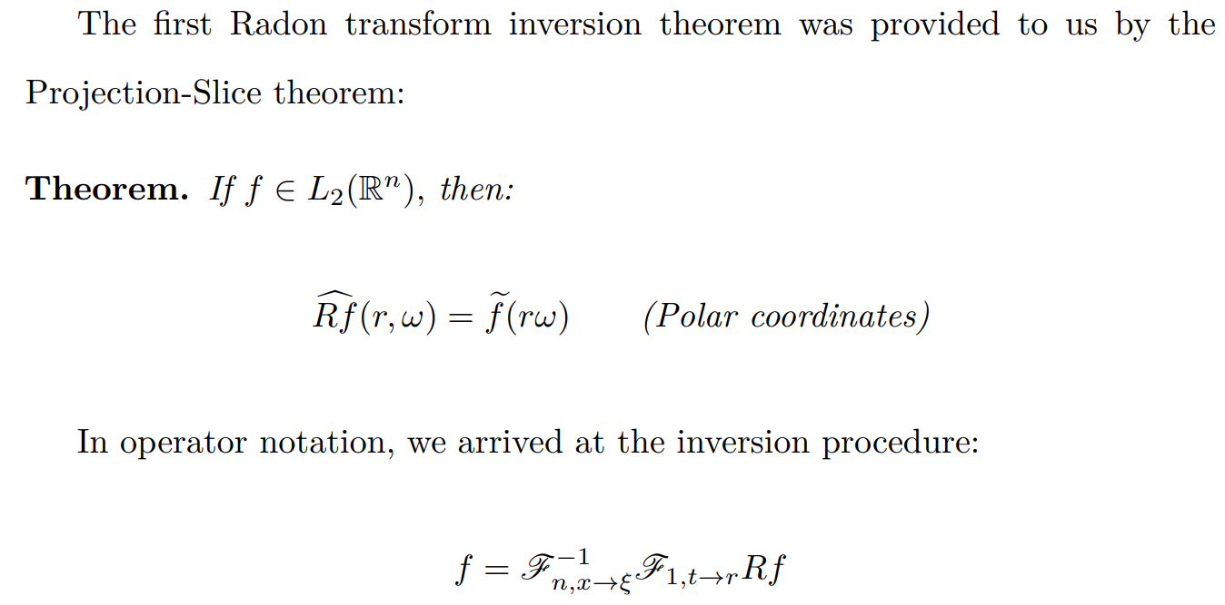
Projection Slice Formula

Slide 6
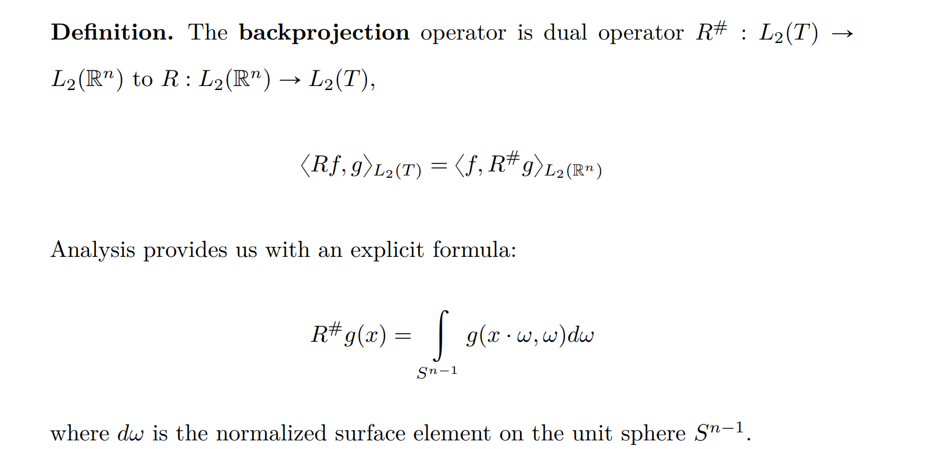
Backprojection Operator

Slide 7


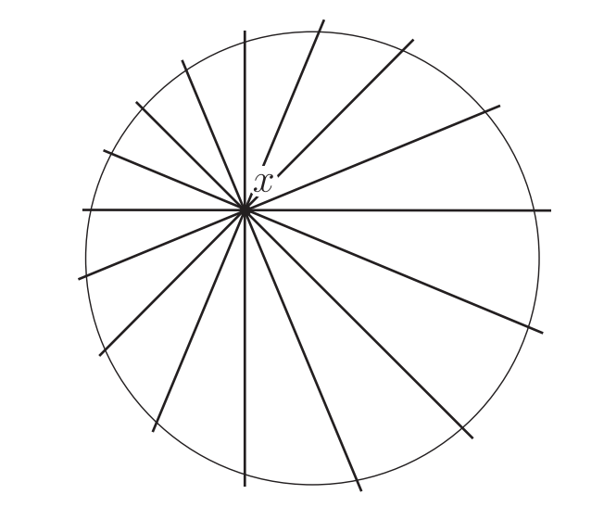
Backprojection Operator

Slide 8
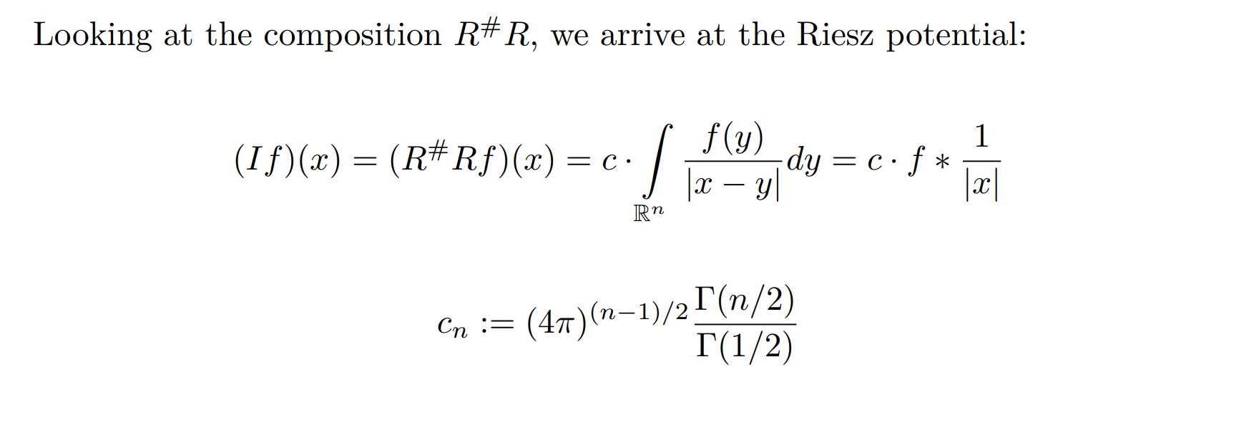

Riesz Potential

Slide 9
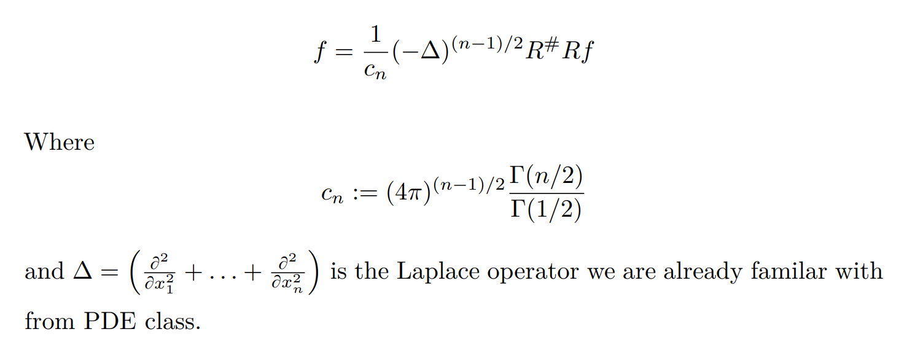
Another Inversion Formula

Slide 10

Odd VS Even Dimensions

Slide 11
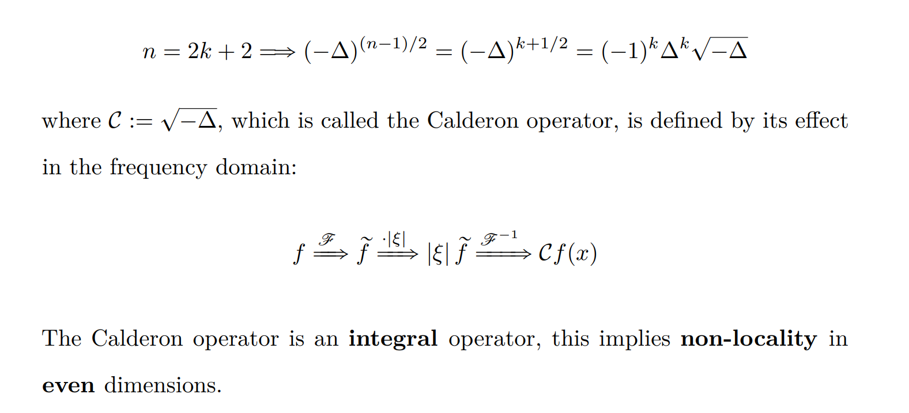
Odd VS Even Dimensions

